Slide 1



Re-Imagining Transborder Passages: Lessons from Community-Based Participatory Research in the Paso del Norte Region
Dr. Neil Harvey, Department of Political Science, Public Law and Administration, New Mexico State University, Dr. Jeremy Slack, Department of Sociology and Anthropology, University of Texas-El Paso and participants in the Summer 2025 National Science Foundation (NSF) Research Experience for Undergraduates (NSF REU) Collaborative Site Program on Immigration Policy and US-Mexico Border Communities. Award 2149449
https://borderreu.nmsu.edu/
Melanie Lopez, Irma Sandoval Moran, Noemí Gutiérrez, Ruben Morales, Jr., Megan White, Mica Faull, and Tatiana Prieto
Presentation at the 25th Imagining America National Gathering
https://iagathering.org/
New Mexico State University, Las Cruces
October 3-5, 2025

Slide 2

Community-Based Participatory Research (CBPR) and our NSF-REU program
1. why we chose CBPR
2. what is CBPR? (Schensul et al) – advantages and criticisms
3. how applied in our program (Harvey et al. “Searching for Safety…”)
4. Examples from 2025
5. Looking forward

Slide 3

1. Why we chose CBPR
Slack – experience at U. Arizona
Harvey – service-learning class
Desire to produce meaningful results and products
NSF criteria: intellectual merit and societal benefit

Slide 4


2. What is CBPR?
One of approaches for transformational research
Three main aspects
A) partnerships with community organizations, minimizing inequalities
B) new knowledge to bring about change
C) involvement of community members at all stages in the research

Slide 5

7 advantages
1. Collaborative rather than extractive
2. Local, community knowledge valued
3. Interests of the community are represented in the research questions
4. Co-learning process
5. Iterative and reflexive effort during the research
6. Discussion of findings prior to publication
7. Return of publications to community

Slide 6

Criticisms of CBPR
Lack of “objectivity”
Time commitment
Complexity of “community”

Slide 7
3. Usefulness of CBPR in shifting policy environments
Increased interior enforcement and sanctuary policies (2017);
zero tolerance and child separation (2018);
Remain in Mexico/MPP (2019);
COVID & Title 42 (2020-21);
Asylum and CBP One, long waits and dangerous conditions in Cd. Juárez (2023 and 2024);
End of CBP One, increased militarization, announcement of National Defense Areas (NDA’s) (2025)

Slide 8

Positives of CBPR for us
1. connects students to people in community on mutually agreed projects
2. encourages discipline to concentrate on daily events and details (use of field journals)
3. contributes to change

Slide 9

Products on our website
https://borderreu.nmsu.edu/
https://borderreu.nmsu.edu/scholarly-products/list-all-products.html

Slide 10
4. Examples from 2025
Sessions at Imagining America 2025
https://iagathering.org/program-at-a-glance/
Student researchers
Community organizations

Slide 11
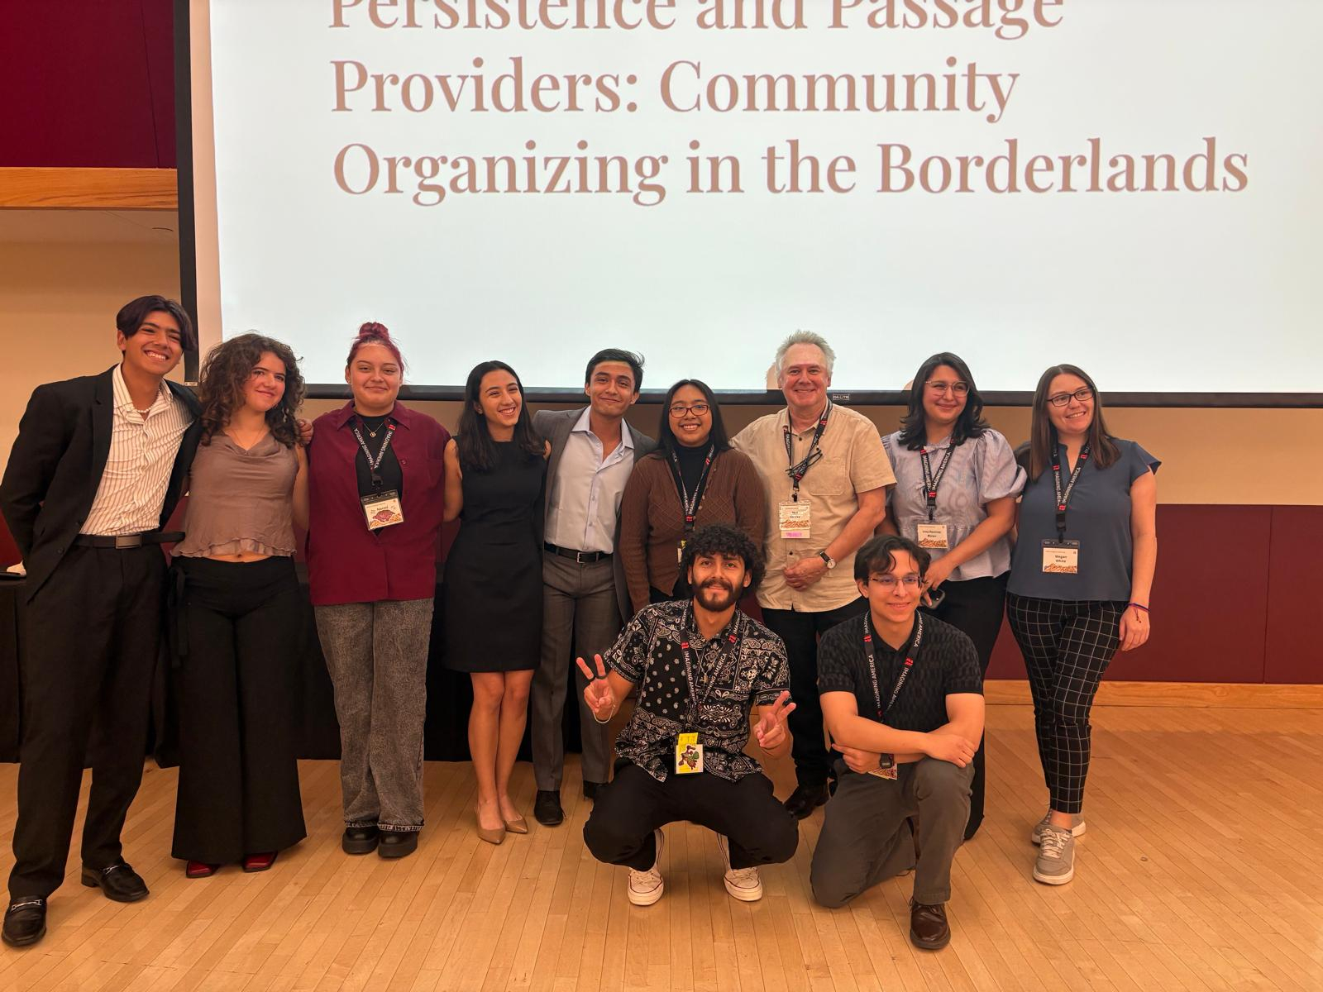
REU presentation at 25th National Imagining America Gathering, NMSU, Oct 3-5, 2025

Slide 12
5. Looking forward
Undergrad and Masters programs in Political Science and Public Administration at NMSU: https://deptofgov.nmsu.edu/
Interdisciplinary Ph.D. in Transborder & Global Human Dynamics at NMSU: https://transborder.nmsu.edu/
Migration and Integration: Service-Learning Program in Germany, Summer 2026 – led by Dr. Sabine Hirschauer, Political Science, NMSU: https://studyabroad.nmsu.edu/index.cfm?FuseAction=Programs.ViewProgramAngular&id=57982
Ph.D. in Sociology (with Border focus), University of Texas-El Paso (UTEP): https://www.utep.edu/programs/graduate/sociology-phd.html

